Slide 1
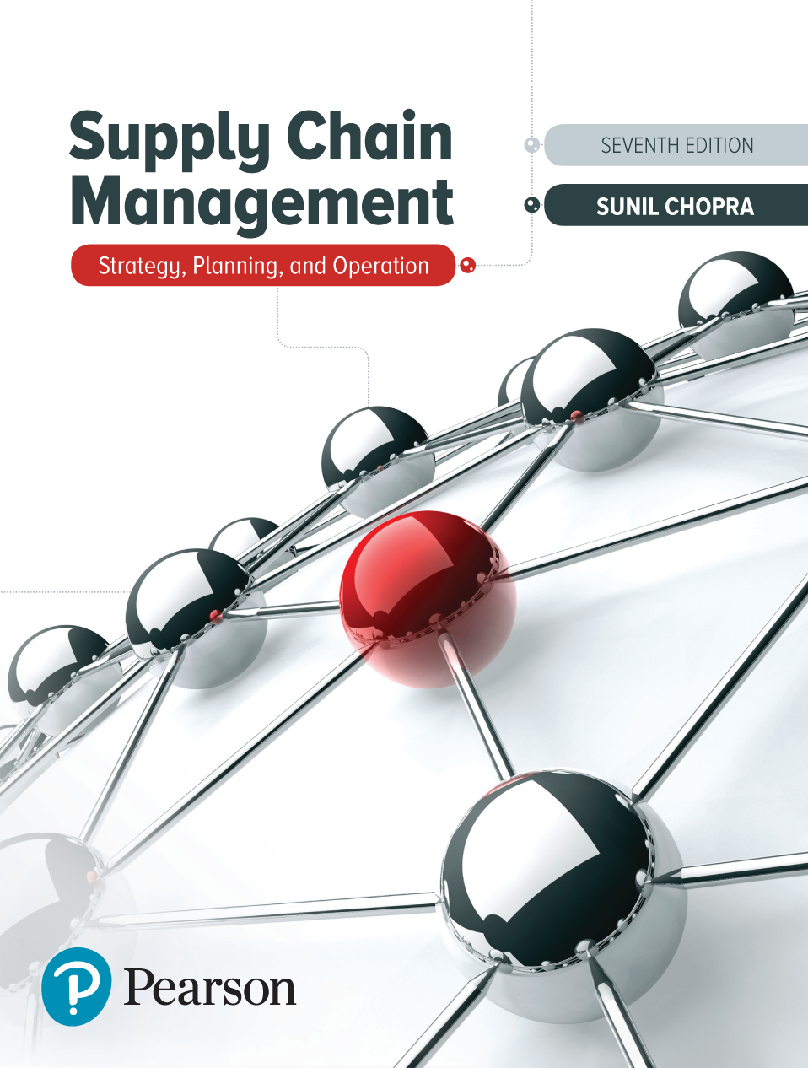
Supply Chain Management: Strategy, Planning, and Operation
Seventh Edition
Chapter 1
Understanding the Supply Chain
Copyright © 2019, 2016, 2013 Pearson Education, Inc. All Rights Reserved
Notes:
If this PowerPoint presentation contains mathematical equations, you may need to check that your computer has the following installed:
1) MathType Plugin
2) Math Player (free versions available)
3) NVDA Reader (free versions available)

Slide 2
Learning Objectives
1.1 Discuss the goal of a supply chain and explain the impact of supply chain decisions on the success of a firm.
1.2 Define the three key supply chain decision phases and explain the significance of each one.
1.3 Describe the cycle and push/pull views along with the macro processes of a supply chain.
1.4 Identify important issues and decisions to be addressed in a supply chain.
1.5 Develop skill that employers have identified as critical to success in the workplace.

Slide 3
What Is a Supply Chain? (1 of 3)
All parties involved, directly or indirectly, in fulfilling a customer request
Includes manufacturers, suppliers, transporters, warehouses, retailers, and customers
Within each organization, the supply chain includes all functions involved in receiving and fulfilling a customer request (new product development, marketing, operations, distribution, finance, customer service)

Slide 4
What Is a Supply Chain? (2 of 3)
Customer is an integral part of the supply chain
Includes movement of products from suppliers to manufacturers to distributors and information, funds, and products in both directions
May be more accurate to use the term “supply network” or “supply web”
Typical supply chain stages: customers, retailers, wholesalers, distributors, manufacturers, suppliers

Slide 5
What Is a Supply Chain? (3 of 3)
Figure 1-1 Stages of an Automotive Supply Chain
Notes:
Notes:
Supply chain involves everybody, from the customer all the way to the last supplier.
Key flows in the supply chain are - information, product, and cash. It is through these flows that a supply chain fills a customer order. The management of these flows is key to the success or failure of a firm. Give Dell & Compaq example, Amazon & Borders example to bring out the fact that all supply chain interaction is through these flows.

Slide 6
Flows in a Supply Chain
Figure 1-2 The Three Flows in a Supply Chain

Slide 7
The Objective of a Supply Chain (1 of 3)
Maximize net value generated
Supply Chain Surplus = Customer Value − Supply Chain Cost

Slide 8
The Objective of a Supply Chain (2 of 3)
Example: a customer purchases a wireless router from Best Buy for $60 (revenue)
Supply chain incurs costs (convey information, produce components, storage, transportation, transfer funds, etc.)
Difference between $60 and the sum of all of these costs is the supply chain profitability
Supply chain profitability is total profit to be shared across all stages of the supply chain
Success should be measured by total supply chain surplus, not profits at an individual stage

Slide 9
The Objective of a Supply Chain (3 of 3)
Customer the only source of revenue
Sources of cost include flows of information, products, or funds between stages of the supply chain
Effective supply chain management involves the management of supply chain assets and product, information, and fund flows to grow the total supply chain surplus

Slide 10
Importance of Supply Chain Decisions
Wal-Mart, $1 billion sales in 1980 to $482 billion in 2016
Seven-Eleven Japan, ¥1 billion sales in 1974 to ¥2.7 trillion in 2016
Webvan folded in two years
Borders, $4 billion in 2004, declared bankruptcy in 2010
Dell, $56 billion in 2006, adopted new supply chain strategies

Slide 11
Summary of Learning Objective 1
The goal of a supply chain should be to grow overall supply chain surplus. Supply chain surplus is the difference between the value generated for the customer and the total cost incurred across all stages of the supply chain. A focus on the supply chain surplus increases the size of the overall pie for all members of the supply chain. Supply chain decisions have a large impact on the success or failure of each firm because they significantly influence both the revenue generated and the cost incurred. Successful supply chains manage flows of product, information, and funds to provide a high level of product availability to the customer while keeping costs low.

Slide 12
Decision Phases in a Supply Chain
Supply chain strategy or design
How to structure the supply chain over the next several years
Supply chain planning
Decisions over the next quarter or year
Supply chain operation
Daily or weekly operational decisions

Slide 13
Supply Chain Strategy or Design
Decisions about the configuration of the supply chain, allocation of resources, and what processes each stage will perform
Strategic supply chain decisions
Outsource supply chain functions
Locations and capacities of facilities
Products to be made or stored at various locations
Modes of transportation
Information systems
Supply chain design must support strategic objectives
Supply chain design decisions are long-term and expensive to reverse – must take into account market uncertainty

Slide 14
Supply Chain Planning (1 of 2)
Definition of a set of policies that govern short-term operations
Fixed by the supply configuration from strategic phase
Goal is to maximize supply chain surplus given established constraints
Starts with a forecast of demand in the coming year

Slide 15
Supply Chain Planning (2 of 2)
Planning decisions:
Which markets will be supplied from which locations
Planned buildup of inventories
Subcontracting
Inventory policies
Timing and size of market promotions
Must consider demand uncertainty, exchange rates, competition over the time horizon in planning decisions

Slide 16
Supply Chain Operation
Time horizon is weekly or daily
Decisions regarding individual customer orders
Supply chain configuration is fixed and planning policies are defined
Goal is to handle incoming customer orders as effectively as possible
Allocate orders to inventory or production, set order due dates, generate pick lists at a warehouse, allocate an order to a particular shipment, set delivery schedules, place replenishment orders
Much less uncertainty (short time horizon)

Slide 17
Summary of Learning Objective 2
Supply chain decisions may be characterized as strategic (design), planning, or operational, depending on the time horizon over which they apply. Strategic decisions relate to supply chain configuration. These decisions have a long-term impact that lasts for several years. Strategic decisions define the constraints for planning decisions, and planning decisions define the constraints for operational decisions. Planning decisions cover a period of a few months to a year and include decisions regarding production plans, subcontracting, and promotions over that period. Operational decisions span from minutes to days and include sequencing production and filling specific orders.

Slide 18
Process Views of a Supply Chain
Cycle View: The processes in a supply chain are divided into a series of cycles, each performed at the interface between two successive stages of the supply chain.
Push/Pull View: The processes in a supply chain are divided into two categories, depending on whether they are executed in response to a customer order or in anticipation of customer orders. Pull processes are initiated by a customer order, whereas push processes are initiated and performed in anticipation of customer orders.

Slide 19
Cycle View of Supply Chain Processes (1 of 2)
Figure 1-3 Supply Chain Process Cycles
Notes:
The supply chain is a concatenation of cycles with each cycle at the interface of two successive stages in the supply chain. Each cycle involves the customer stage placing an order and receiving it after it has been supplied by the supplier stage.
One difference is in size of order. Second difference is in predictability of orders - orders in the procurement cycle are predictable once manufacturing planning has been done.
This is the predominant view for ERP systems. It is a transaction level view and clearly defines each process and its owner.

Slide 20
Cycle View of Supply Chain Processes (2 of 2)
Figure 1-4 Subprocesses in Each Supply Chain Process Cycle

Slide 21
Push/Pull View of Supply Chain Processes
Supply chain processes fall into one of two categories depending on the timing of their execution relative to customer demand
Pull: execution is initiated in response to a customer order (reactive)
Push: execution is initiated in anticipation of customer orders (speculative)
Push/pull boundary separates push processes from pull processes

Slide 22
Figure 1-5 Push/Pull View of Supply Chains
Notes:
In this view processes are divided based on their timing relative to the timing of a customer order. Define push and pull processes.
They key difference is the uncertainty during the two phases.
Give examples at Amazon and Borders to illustrate the two views

Slide 23
Push/Pull View – L . L. Bean
Figure 1-6 Push/Pull Processes for the L. L. Bean Supply Chain

Slide 24
Push/Pull View – Ethan Allen
Figure 1-7 Push/Pull Processes for Ethan Allen Supply Chain for Customized Furniture

Slide 25
Supply Chain Macro Processes
Supply chain processes discussed in the two views can be classified into
1. Customer Relationship Management (C R M):
all processes at the interface between the firm and its customers
2. Internal Supply Chain Management (I S C M):
all processes that are internal to the firm
3. Supplier Relationship Management (S R M):
all processes at the interface between the firm and its suppliers

Slide 26
Figure 1-8 Supply Chain Macro Processes

Slide 27
Summary of Learning Objective 3 (1 of 2)
The cycle view divides processes into cycles, each performed at the interface between two successive stages of a supply chain. Each cycle starts with an order placed by one stage of the supply chain and ends when the order is received from the supplier stage. A push/pull view of a supply chain characterizes processes based on their timing relative to that of a customer order. Pull processes are performed in response to a customer order, whereas push processes are performed in anticipation of customer orders.

Slide 28
Summary of Learning Objective 3 (2 of 2)
All supply chain processes within a firm can be classified into three macro processes: C R M, I S C M, and S R M. The C R M macro process consists of all processes at the interface between the firm and the customer that work to generate, receive, and track customer orders. The I S C M macro process consists of all supply chain processes that are internal to the firm and work to plan for and fulfill customer orders. The S R M macro process consists of all supply chain processes at the inter- face between the firm and its suppliers that work to evaluate and select suppliers and then source goods and services from them. Integration among the three macro processes is crucial for successful supply chain management.

Slide 29
Examples of Supply Chains
Gateway and Apple
Zara
W.W. Grainger and McMaster-Carr
Toyota
Amazon
Macy's
Notes:
Dell has three production sites worldwide and builds to order. Compaq does both. Consider some decisions involved - where to locate facilities? How to size them? Where is the push/pull boundary? What modes of transport to use? How much inventory to carry? In what form? Where to source from?

Slide 30
Gateway and Apple
Why did Gateway choose not to carry any finished-product inventory at its retail stores? Why did Apple choose to carry inventory at its stores?
What are the characteristics of products that are most suitable to be carried in finished-goods inventory in a retail store? What characterizes products that are best manufactured to order?
How does product variety affect the level of inventory a retail store must carry?
Is a direct selling supply chain without retail stores always less expensive than a supply chain with retail stores?
What factors explain the success of Apple retail and the failure of Gateway Country stores?

Slide 31
Zara
What advantage does Zara gain against the competition by having a very responsive supply chain?
Why has Inditex chosen to have both in-house manufacturing and outsourced manufacturing? Why has Inditex maintained manufacturing capacity in Europe even though manufacturing in Asia is much cheaper?
Why does Zara source products with uncertain demand from local manufacturers and products with predictable demand from Asian manufacturers?
What advantage does Zara gain from replenishing its stores multiple times a week compared to a less frequent schedule?
Do you think Zara’s responsive replenishment infrastructure is better suited for online sales or retail sales?

Slide 32
W.W. Grainger and McMaster-Carr
How many D Cs should be built and where should they be located?
How should product stocking be managed at the D Cs? Should all D Cs carry all products?
What products should be carried in inventory and what products should be left with the supplier to be shipped directly in response to a customer order?
What products should W.W. Grainger carry at a store?
How should markets be allocated to D Cs in terms of order fulfillment? What should be done if an order cannot be completely filled from a D C? Should there be specified backup locations? How should they be selected?

Slide 33
Toyota
Where should the plants be located, and what degree of flexibility should be built into each? What capacity should each plant have?
Should plants be able to produce for all markets or only for specific contingency markets?
How should markets be allocated to plants and how frequently should this allocation be revised?
How should the investment in flexibility be valued?

Slide 34
Amazon
Why is Amazon building more warehouses as it grows? How many warehouses should it have, and where should they be located?
Should Amazon stock every product it sells?
What advantage can online players derive from setting up a brick-and-mortar location? How should they use the two channels to gain maximum advantage?
What advantages and disadvantages does the online channel enjoy in the sale of shoes and diapers relative to a retail store?
For what products does the online channel offer the greater advantage relative to retail stores? What characterizes these products?

Slide 35
Macy’s and W.W. Grainger
Should online orders be filled from stores or fulfillment centers? What role(s) should each facility play?
How should store inventories be managed in an omni-channel setting?
Should returns be kept at a store or sent to a fulfillment center?

Slide 36
Summary of Learning Objective 4 (1 of 2)
At a strategic level, a supply chain designer must decide whether to build a responsive supply chain like Zara or focus on lower costs. A decision must be made on the location and capacity of each facility and whether it will be dedicated or flexible in terms of the products it produces and markets it serves. The designer must decide whether products will be sold directly to customers, through distributors like Grainger, or through brick-and-mortar retailers like Macy’s. If opting for omni-channel retail, the designer must decide which facilities will fulfill different customer orders.

Slide 37
Summary of Learning Objective 4 (2 of 2)
The planner must then decide on the production levels at each production site and inventory levels at each D C and retail store. As customer orders arrive, the operations manager must decide how each order will be fulfilled given the available inventory and production schedule. The goal when making all these decisions is to maximize the supply chain surplus.

Slide 38
Developing Skills for Your Career
Lessons learned in this book will help develop career skills no matter what path you take
Employers have identified communication, critical thinking, collaboration, knowledge application and analysis, business ethics and social responsibility, data literacy, and information technology application and computing skills as critical
Link between strategic decision making and analytics

Slide 39
Summary of Learning Objective 5
Skills learned in this book will be of great use no matter what path students choose to follow. The book is developed with the premise that good strategic decisions cannot be made without access to relevant analytics, and all analytics should be designed to support decision making. As a result, students will develop critical thinking, the ability to formulate and analyze problems, and support their recommendations with analytics that uses data literacy and computing skills.

Slide 40
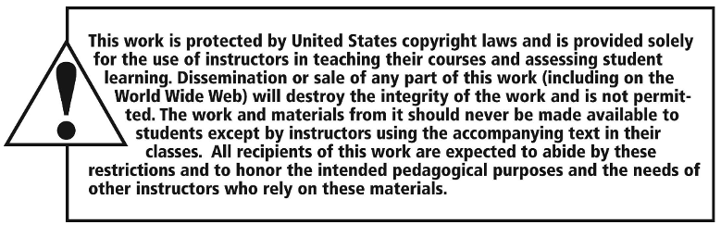
Copyright

